Slide 1



The Impact of recreational Technology use on mental health
Cordette Gillis
Inshirah Khatib
Logan Dameron

Slide 2
Hypothesis and Research Questions
Hypothesis: Recreational technology use (Gaming and Social Media ) negatively impacts our mental health.
1. Does recreational technology use negatively impact our mental health?
2. Is the impact different depending on age?
3. Is the impact different depending on gender?
4. Do hours spent on social media correlate negatively with mental health?
5. Do hours spent gaming correlate negatively with mental health?
Notes:
Logan can do this !

Slide 3

Why it matters?
Technology, especially smartphones, computers, and the internet, is omnipresent. Studies show that the average person spends several hours daily on digital devices, engaging in activities such as social media, gaming, online education, and virtual meetings. This prevalence makes technology usage a significant determinant of behavioral, mental, and social patterns.
Notes:
Inshirah (Cordette can fill in any additional info if needed)
Discuss how technology plays a role (broad overview on technology in every day lives).
Pervasiveness in Daily Life
Mental Health Implications
Physical Health Implications
Social and Cultural Dynamics
We will focus on how technology plays a role on our mental health. The topics discussed will be the effects of social media and gaming on our mental health and stress. Analyzing the impacts by age and gender.

Slide 4
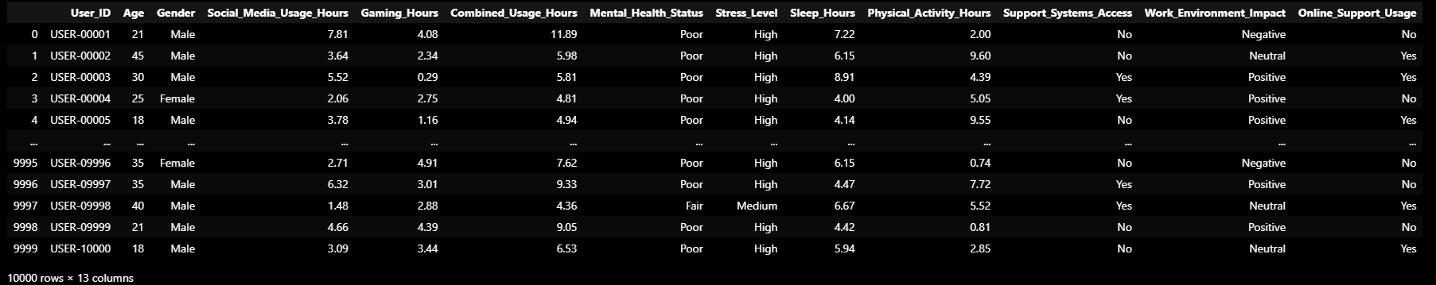
Data Source
https://www.kaggle.com/datasets/waqi786/mental-health-and-technology-usage-dataset
Notes:
Cordette

Slide 5

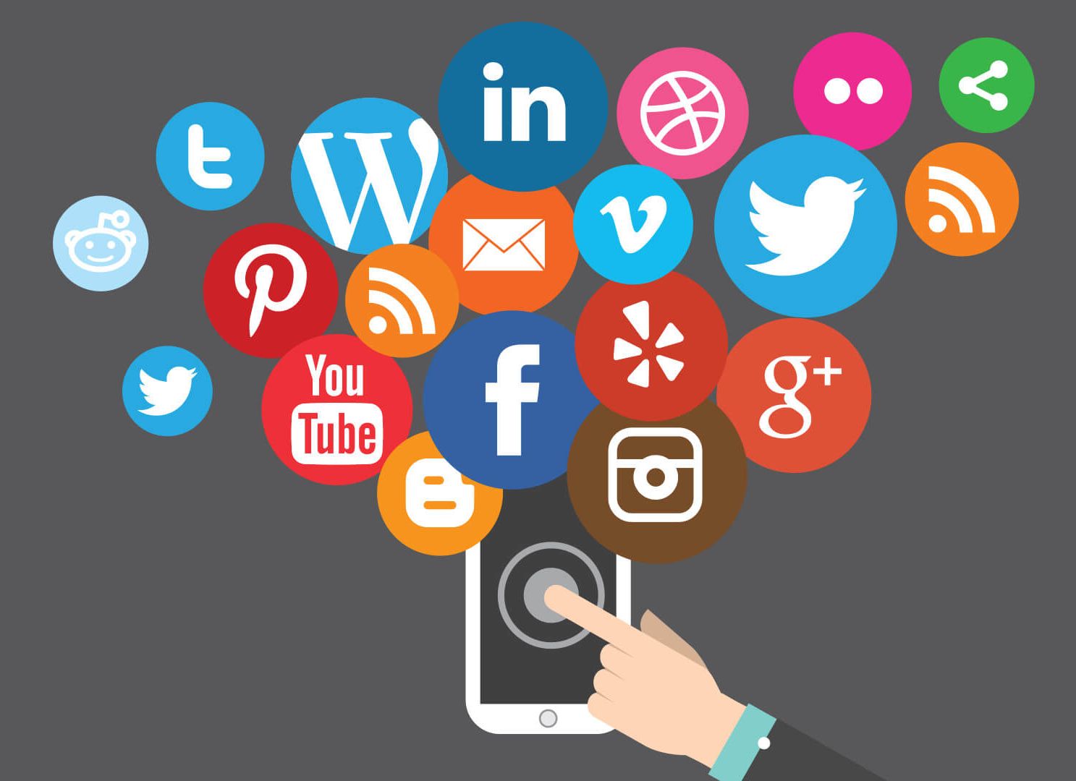
Visuals & analysis
This Photo by Unknown Author is licensed under CC BY-SA

Slide 6
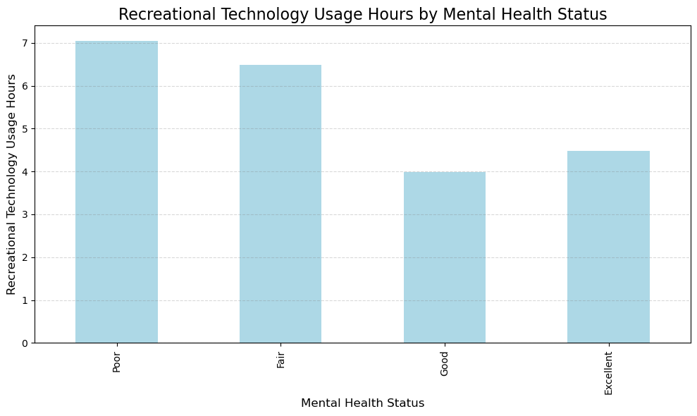
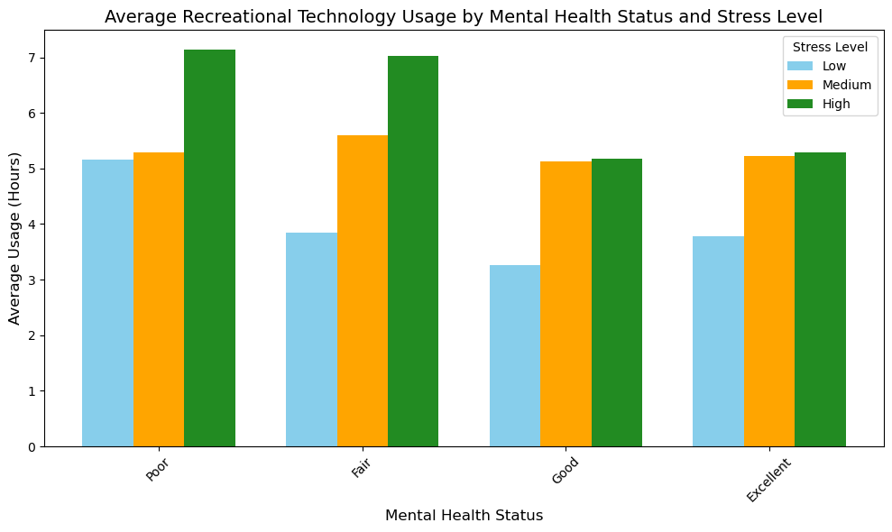
Visual 1
Does recreational technology use negatively impact our mental health?
Notes:
Cordette
General Trend:
The bar graph highlights the relationship between average combined usage hours and mental health status categories (e.g., "Poor," "Neutral," "Good").
Higher combined usage hours are often associated with poorer mental health, suggesting that excessive screen time or digital engagement might negatively impact mental well-being.
Key Observations:
Poor Mental Health: This category tends to show the highest average combined usage hours. This may imply a potential link between heavy technology use and mental health challenges, such as stress, anxiety, or depression.
Neutral Mental Health: Individuals with neutral mental health status exhibit moderate combined usage hours, suggesting more balanced or healthier usage patterns compared to those with poor mental health.
Good Mental Health: This group shows the lowest combined usage hours on average. This aligns with findings that limited screen time and balanced technology use may contribute to better mental well-being.
The bar graph emphasizes a strong association between higher combined usage hours and poorer mental health. This insight is valuable for promoting digital wellness strategies and understanding how technology use impacts mental health.
For Intervention: Reducing excessive technology usage might help improve mental health outcomes, especially for individuals in the "Poor" mental health category.

Slide 7
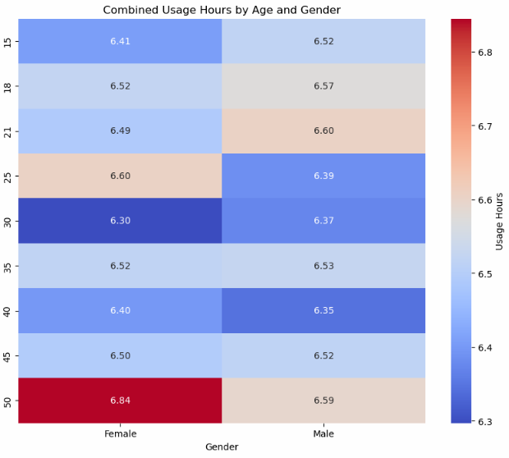
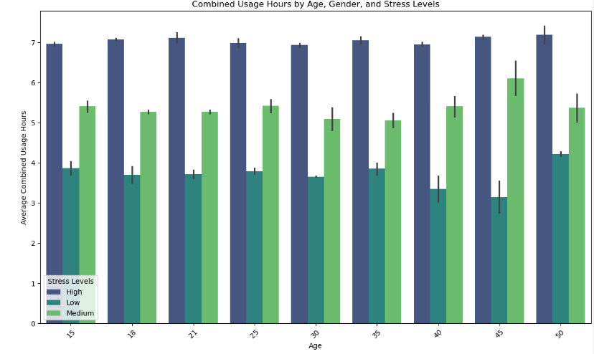
Visuals 2
Is the impact different depending on age?
Notes:
Inshirah
General Trends Across Age:
Younger age groups (e.g., teens and early 20s) tend to have higher combined usage hours for both genders, likely reflecting increased engagement with social media and gaming platforms.
As age increases, combined usage hours generally decrease, indicating a possible shift in priorities (e.g., work, family) or lower interest in technology-intensive activities.
Peaks of usage can be observed in certain younger age brackets, suggesting specific life stages (e.g., high school or college years) when technology usage is at its highest. The tapering of usage for older adults is consistent with broader studies on technology adoption and usage patterns.
Gender-Based Differences:
At most ages, males show slightly higher combined usage hours than females. This might be attributed to higher gaming activity among males, as gaming often contributes significantly to combined usage.
The disparity between genders appears more pronounced in younger age groups and less significant in older age groups, where overall usage is lower.
Implications for Stress Levels:
While this heatmap does not directly correlate usage with stress levels, the observed high usage hours among younger populations may align with higher stress levels seen in separate analyses. This could be explored further to understand whether heavy technology usage contributes to stress or serves as a coping mechanism.

Slide 8
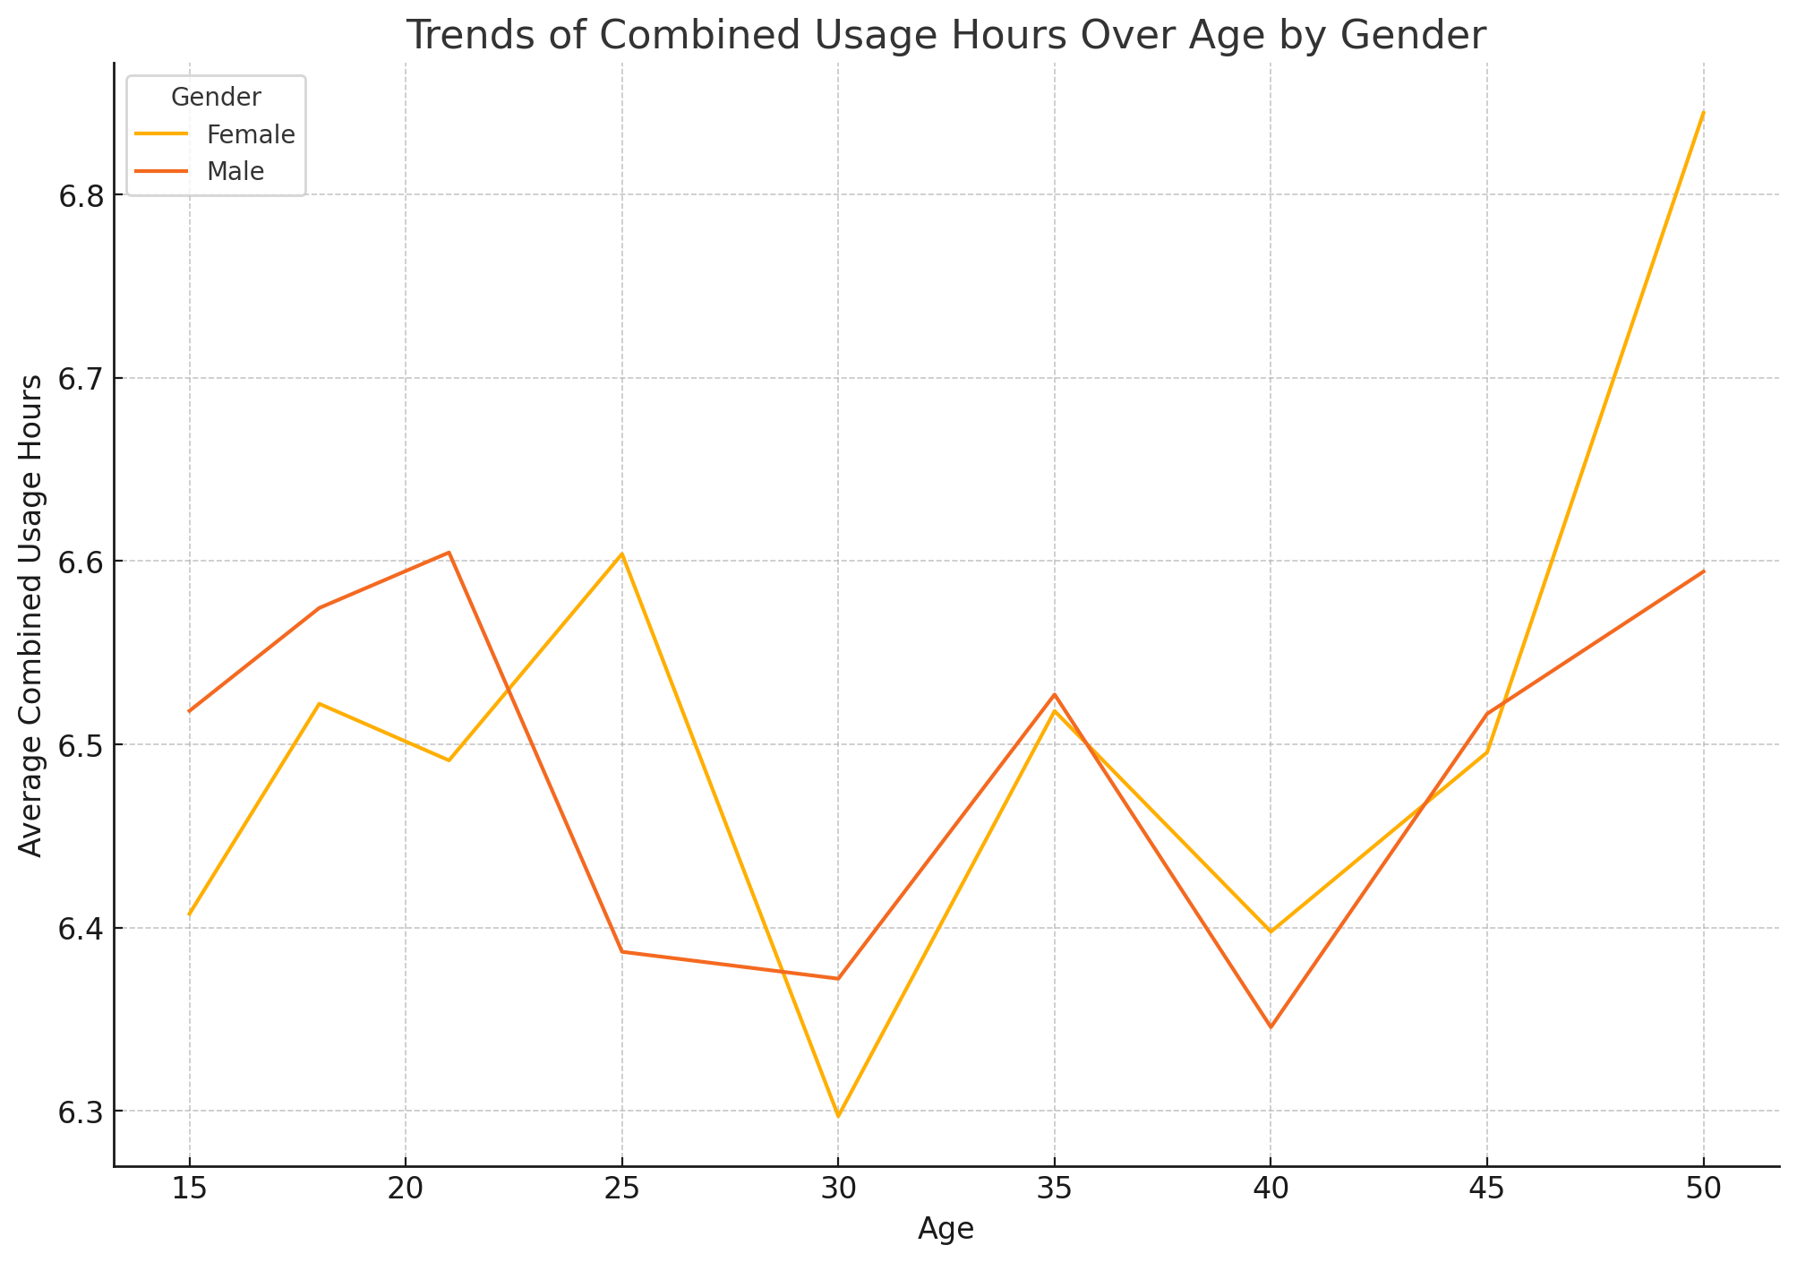
Is the impact different depending on gender?
Visual 3
Notes:
Inshirah
Gender-Specific Differences:
For each mental health category, males generally have higher combined usage hours compared to females.
The disparity is particularly pronounced in the "Poor" mental health category, suggesting that males with poor mental health tend to engage more heavily in activities like social media and gaming.
Mental Health Trends:
For both genders, individuals with "Poor" mental health exhibit the highest combined usage hours, while those with "Good" mental health show the lowest.
This trend aligns with the general assumption that excessive screen time correlates with poorer mental health.
Smaller Differences in "Good" Category:
In the "Good" mental health category, the difference in combined usage hours between males and females is smaller, suggesting more balanced usage among individuals with better mental health.

Slide 9
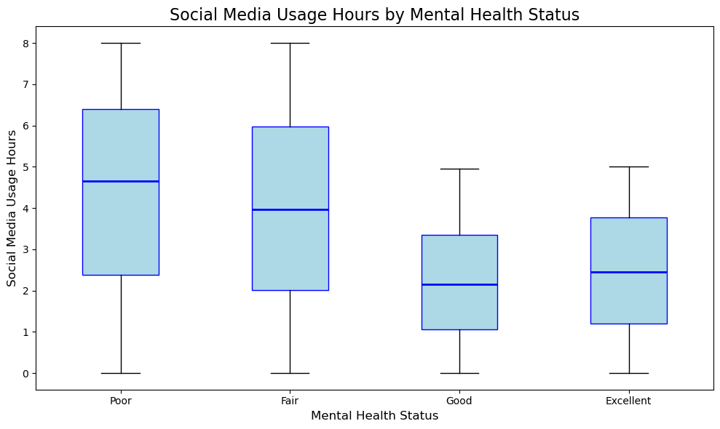
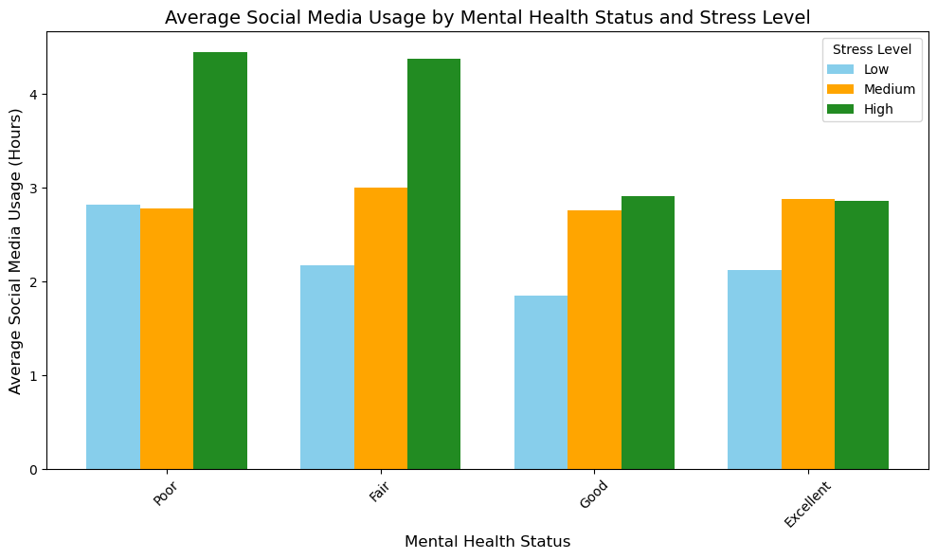
Visual 4
Do hours on social media correlate negatively with mental health?
Notes:
Cordette

Slide 10
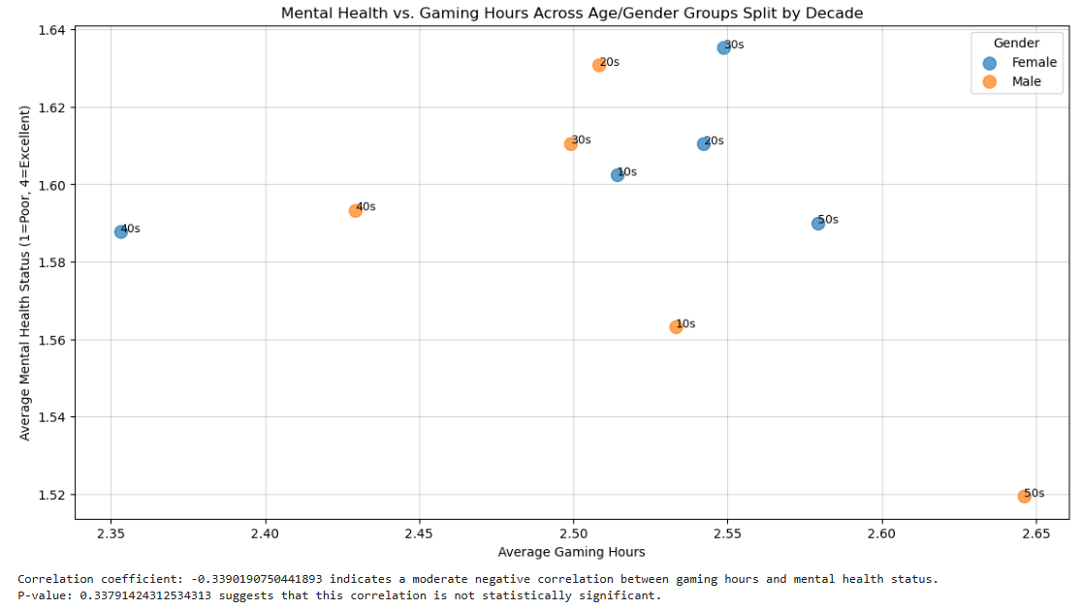
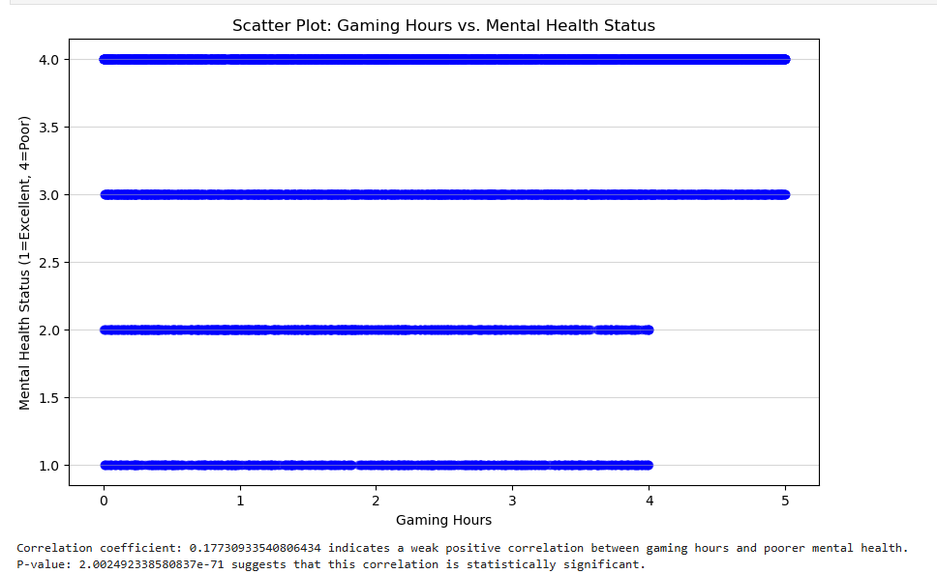
Visual 5
Do hours gaming correlate negatively with mental health?
Note: Mental Health Status (1=Excellent, 4=Poor)
Correlation coefficient: -0.3390190750441893 indicates a moderate negative correlation between gaming hours and mental health status.
P-value: 0.33791424312534313 suggests that this correlation is not statistically significant.
Correlation coefficient: 0.17730933540806434 indicates a weak positive correlation between gaming hours and poorer mental health.
P-value: 2.002492338580837e-71 suggests that this correlation is statistically significant.
Notes:
Initially, we looked at Mental Health vs. Gaming hours Across different age/gender groups. We did find a moderate correlation between gaming hours and mental health, but the p-value suggested that this correlation was not statistically significant, so we had to approach from a more general angle.
If we look at just gaming hours vs. mental health status - Our analysis of gaming hours and mental health status showed an interesting, albeit weak, connection.
We found a correlation coefficient of about 0.177, suggesting that people who spend more time gaming may report slightly poorer mental health. You can see for yourself on the scatter plot. People who gamed less, did report better mental health status. Further, the p-value was incredibly small meaning this result is statistically significant – not due to chance. Not the decimal to the negative 71st power.
However, it’s important to note that while the data shows some link between gaming and mental health, the weak correlation hints that gaming isn’t the main factor affecting mental health.

Slide 11
Conclusion
The dataset highlights a strong relationship between technology usage, mental health, age, and gender.
Younger individuals, especially males, have the highest combined usage hours, driven largely by gaming and social media.
High combined usage hours are strongly associated with poor mental health, indicating potential negative effects of excessive screen time.
Males consistently exhibit higher usage across all mental health categories, with a pronounced gap in the "Poor" mental health group.
The data does not establish causality, leaving open the question of whether heavy usage causes poor mental health or serves as a coping mechanism.
Notes:
Logan
The dataset reveals significant insights into the relationship between technology usage, mental health, age, and gender. Younger individuals, particularly males, exhibit higher combined usage hours, with activities like gaming and social media contributing significantly. High combined usage hours are strongly associated with poor mental health, suggesting a potential negative impact of excessive screen time. Gender differences are notable, as males consistently show higher usage across all mental health categories, especially among those with poor mental health. However, the data does not establish causality—whether heavy usage causes poor mental health or serves as a coping mechanism remains unclear. These findings highlight the need for targeted interventions, particularly for younger males and individuals with high stress levels, to promote balanced technology habits and improve mental well-being.

Slide 12
Resources
https://www.kaggle.com/datasets/waqi786/mental-health-and-technology-usage-dataset
Teens are spending nearly 5 hours daily on social media. Here are the mental health outcomes

